Slide 1
Building RESTful Service with Windows Communication Foundation (WCF)

Slide 2
Objectives
Windows Communication Foundation (WCF) Concepts
Features of WCF
WCF Architecture
WCF Service Design
WCF Client
Demo WCF application

Slide 3
What Is Windows Communication Foundation?
WCF is Microsoft’s unified programming model for building service-oriented applications.
WCF enables developers to build secure, reliable, transacted solutions that integrate across platforms and interoperate with existing investments.

Slide 4
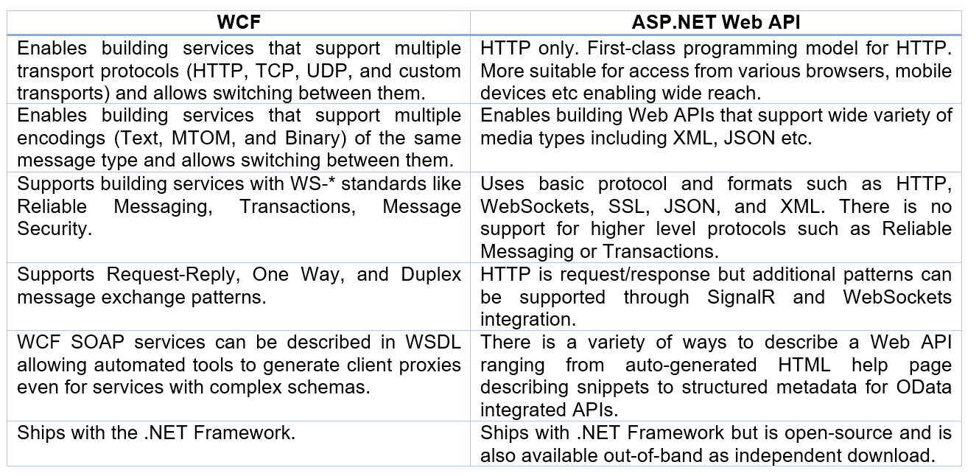
Choosing which technology to use

Slide 5
Features of WCF
Service Orientation
Interoperability
Multiple Message Patterns
Service Metadata
Data Contracts
Security
Multiple Transports and Encodings.
Reliable and Queued Messages
Durable Messages
Transactions
AJAX and REST Support
Extensibility
Notes:
https://docs.microsoft.com/en-us/dotnet/framework/wcf/whats-wcf

Slide 6
WCF Integration with Other Technologies
The first technology to pair with WCF was the Windows Workflow Foundation (WF).
Microsoft BizTalk Server R2 also utilizes WCF as a communication technology. BizTalk is designed to receive and transform data from one standardized format to another.
Microsoft Silverlight is a platform for creating interoperable, rich Web applications that allow developers to create media-intensive Web sites (such as streaming video).
The hosting features of Windows Server AppFabric application server are specifically designed for deploying and managing applications that use WCF for communication.

Slide 7
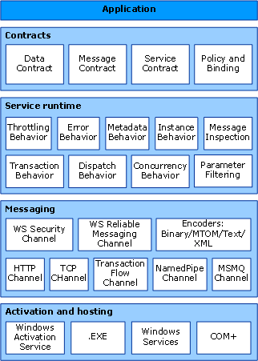
WCF Architecture
Contracts and Descriptions
Service Runtime
Messaging
Hosting and Activation
Notes:
https://docs.microsoft.com/en-us/dotnet/framework/wcf/architecture

Slide 8





WCF - Fundamental Concepts
Messaging and Endpoints
Services and Clients
Endpoints
Client
Service
Message
Message
Client
Service
Endpoint
Endpoint
Message
Endpoint

Slide 9







WCF - Fundamental Concepts - 1
Address, Binding, Contract
Client
Service
Endpoints
Endpoint
C
B
A
C
B
A
Message
C
B
A
Address
Binding
Contract
(Where)
(How)
(What)

Slide 10
WCF - Fundamental Concepts - 2
Communication Protocols
One required element of the communication stack is the transport protocol. Messages can be sent over intranets and the Internet using common transports, such as HTTP and TCP.
Another required element in the communication stack is the encoding that specifies how any given message is formatted. WCF provides the following encodings:
Text encoding, an interoperable encoding.
Message Transmission Optimization Mechanism (MTOM) encoding, which is an interoperable way for efficiently sending unstructured binary data to and from a service.
Binary encoding for efficient transfer.

Slide 11
WCF - Fundamental Concepts - 3
Message Patterns
WCF supports several messaging patterns, including request-reply, one-way, and duplex communication.
Different transports support different messaging patterns, and thus affect the types of interactions that they support.
The WCF APIs and runtime also help you to send messages securely and reliably.

Slide 12

WCF Architecture: Messaging Runtime
Service
Contract
and Behaviors
Client
Dispatcher
Protocol(s)
Protocol(s)
Binding
Encoder
Encoder
Transport
Transport
Address

Slide 13
Contracts - 1
Service Contract
Defines Operations, Behaviors and Communication Shape
Data Contract
Defines Schema and Versioning Strategies
Message Contract
Allows defining application-specific headers and unwrapped body content
What does your service do
What object data is used
Allows control over the SOAP structure of messages
Three Types of Contracts
Ways to Talk
One Way - Datagram-style delivery
Request-Reply - Immediate Reply on same logical thread
Duplex - Reply “later” and on backchannel (callback-style)
One Way
Client
Service
Request-Reply
Duplex (Dual)

Slide 14
Contracts - 2
Service contract − This contract provides information to the client as well as to the outer world about the offerings of the endpoint, and the protocols to be used in the communication process.
Data contract − The data exchanged by a service is defined by a data contract. Both the client and the service has to be in agreement with the data contract.
Message contract − A data contract is controlled by a message contract. It primarily does the customization of the type formatting of the SOAP message parameters.
Policy and Binding − There are certain pre-conditions for communication with a service, and such conditions are defined by policy and binding contract. A client needs to follow this contract.

Slide 15
Service Contracts - 1
A service contract specifies the following:
The operations a contract exposes.
The signature of the operations in terms of messages exchanged.
The data types of these messages.
The location of the operations.
The specific protocols and serialization formats that are used to support successful communication with the service.

Slide 16
Service Contracts - 2
Service Contract
Service Contract: OneWay
using System.ServiceModel;
[ServiceContract]
public interface ICalculate
{
[OperationContract]
double Add( double a, double b);
[OperationContract]
double Subtract( double a, double b);
}
[ServiceContract]
public interface IOneWayCalculator
{
[OperationContract(IsOneWay=true)]
void StoreProblem (ComplexProblem p);
}

Slide 17
Service Contracts - 3
Service Contract: Duplex Asymmetric
Service Contract: Duplex Symmetric
[ServiceContract(Session=true, CallbackContract=typeof(ICalculatorResults)]
public interface ICalculatorProblems {
[OperationContract(IsOneWay=true)]
void SolveProblem (ComplexProblem p);
}
public interface ICalculatorResults {
[OperationContract(IsOneWay=true)]
void Results(ComplexProblem p);
}
[ServiceContract(Session=true, CallbackContract=typeof(IChat)]
public interface Ichat {
[OperationContract(IsOneWay=true)]
void Talk(string text);
}

Slide 18
Data contracts
[DataContract]
public class ComplexNumber
{
[DataMember] public double Real = 0.0D; [DataMember] public double Imaginary = 0.0D;
public ComplexNumber(double r, double i) { this.Real = r; this.Imaginary = i; }
}

Slide 19
Message contracts
[MessageContract]
public class ComplexProblem
{
[MessageHeader] public string operation;
[MessageBody] public ComplexNumber n1;
[MessageBody] public ComplexNumber n2;
[MessageBody] public ComplexNumber solution;
// Constructors…
}

Slide 20
Bindings - 1
TCP Binding − Provided by the NetTCPBinding class, this binding makes use of the TCP protocol for communication within the same network and does the message encoding in binary format. This binding is considered as the most reliable in contrast to others.
WS Dual Binding − This type of binding is more like WSHttpBinding with the only exception that it facilitates bidirectional communication, i.e., messages can be sent and received by both clients and services. It is offered by the WSDualHttpBinding class.
Web binding − Web binding is designed to represent WCF services in the form of HTTP requests by the use of HTTP-GET, HTTP-POST, etc. It is offered by the WebHttpBinding class and is used commonly with social networks.

Slide 21
Bindings - 2
MSMQ Binding − It is offered by the NetMsmqBinding class and is used to provide solutions in case the service processes a message at a distinct time than that sent by the client. MSMQ binding makes use of MSMQ for transportation and provides support to detached message queued. MSMQ is an implementation for message queuing offered by Microsoft.
Federated WS Binding − It is a specific form of WS binding and offers support for federated security. It is offered by the WSFederationHttpBinding class.

Slide 22
Bindings - 3
Peer Network Binding − Offered by the NetPeerTCPBinding class, it is mainly used in file sharing systems. It uses TCP protocol but makes use of peer networking as transport. In this networking, each machine (node) acts as a client and a server to the other nodes. Peer network binding is used in file sharing systems like torrent.
MSMQ Integration Binding − Offered by the MsmqIntegrationBinding class, it helps communicate with existing systems that communicate via MSMQ (Microsoft Message Queuing).

Slide 23




Bindings - 4
Bindings & Behaviors: Security
Client
Service
A
B
C
C
B
A
A
B
C
Be
A
B
C
Be
Bindings Insert Claims in Messages
Behaviors Implement Security Gates

Slide 24
Bindings - 5
Bindings & Behaviors: Transactions
Client
Service
A
B
C
C
B
A
A
B
C
Be
A
B
C
Be
Bindings Flow Transactions
Behaviors AutoEnlist and AutoComplete

Slide 25
Bindings - 6
Bindings & Behaviors: Reliable Sessions
Client
Service
A
B
C
C
B
A
A
B
C
A
B
C
Bindings provide Session and Guarantees

Slide 26
Activation and Hosting - 1
The last layer of WCF architecture is the place where services are actually hosted or can be executed for easy access by the client. This is done by various mechanisms discussed below in brief.
IIS − IIS stands for Internet Information Service. It offers a myriad of advantages using the HTTP protocol by a service. Here, it is not required to have the host code for activating the service code; instead, the service code gets activated automatically.
Windows Activation Service − This is popularly known as WAS and comes with IIS 7.0. Both HTTP and non-HTTP based communication is possible here by using TCP or Namedpipe protocols.

Slide 27
Activation and Hosting - 2
Self-hosting − This is a mechanism by which a WCF service gets self-hosted as a console application. This mechanism offers amazing flexibility in terms of choosing the desired protocols and setting own addressing scheme.
Windows Service − Hosting a WCF service with this mechanism is advantageous, as the services then remain activated and accessible to the client due to no runtime activation.

Slide 28
WCF Service Design
Attributes
ServiceContract – Marks a class or interface as a WCF service
OperationContract – Marks a function as a member of the parent service contract
DataContract – Marks a class or struct as a data type that will be passed to or from the service
DataMember – A property of a data contract that will be passed along with it’s parent object
MessageContract – Allows explicit formatting of messages. Useful for interoperability.

Slide 29
Creating a WCF Service
Every WCF service has three primary components:
A service class, implemented in C# or Visual Basic or another CLR-based language that implements one or more methods.
A host process in which the service runs.
One or more endpoints that allow clients to access the service. All communication with a WCF service happens via the service’s endpoints.
Endpoints
Service Class
WCF
Host Process

Slide 30
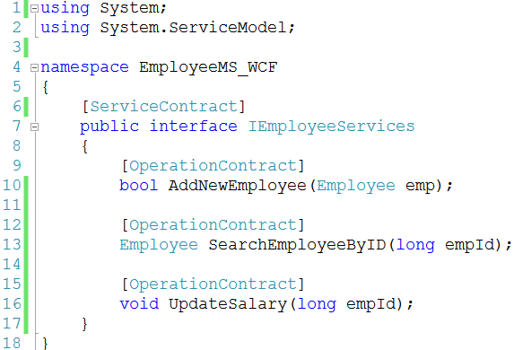
Implementing a Service Class - 1
Defining Service Contracts
A WCF service class specifies a service contract that defines which of its methods are exposed to clients of that service.
Every service class implements methods for its clients to use. The creator of the class determines which of its methods are exposed as client-callable operations by specifying that they are part of some service contract.
To do this, a developer uses the WCF-defined attribute ServiceContract.

Slide 31
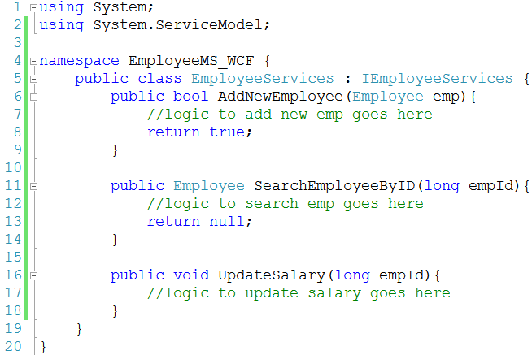
Implementing a Service Class - 2

Slide 32
Implementing a Service Class - 3
Defining Data Contracts
Service class operations will typically convey some data, which means that a service contract also implies some kind of data contract describing the information that will be exchanged.
In some cases, this data contract is defined implicitly as part of the service contract.
But services can also have parameters of more complex types, such as structures. In cases like this, an explicit data contract is required.
Data contracts define how in-memory types are converted to a form suitable for transmission across the wire, a process known as serialization. In effect, data contracts are a mechanism for controlling how data is serialized.
A data contract is defined using the DataContract attribute.

Slide 33
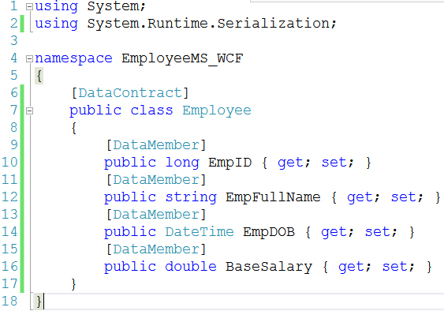
Implementing a Service Class - 4

Slide 34
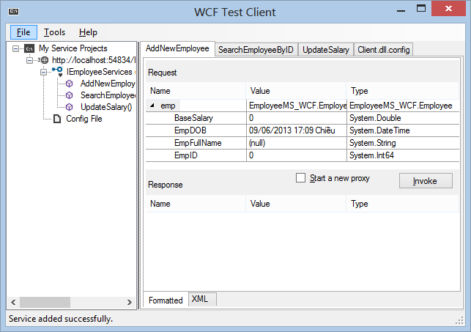
Test WCF

Slide 35
Hosting WCF Service
A WCF service class is typically compiled into a library. By definition, all libraries need a host Windows process to run in.
A WCF service can be hosted in following ways:
Hosting in Internet Information Services(IIS).
Hosting in Windows Activation Services(WAS).
Hosting in a Console or Desktop application(Self hosting).
Hosting in a Windows Service.

Slide 36
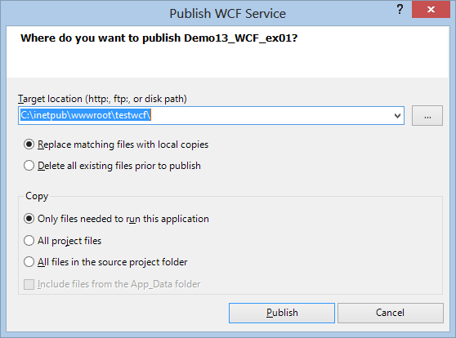
Hosting in Internet Information Services - 1
Right-click on WCF project, select Publish

Slide 37
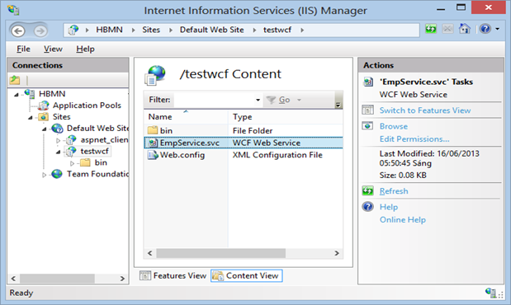
Hosting in Internet Information Services - 2
Create Employee.svc file with content
<%@ServiceHost language=c# Debug="true" Service="Demo13_WCF_ex01.EmployeeService"%>

Slide 38
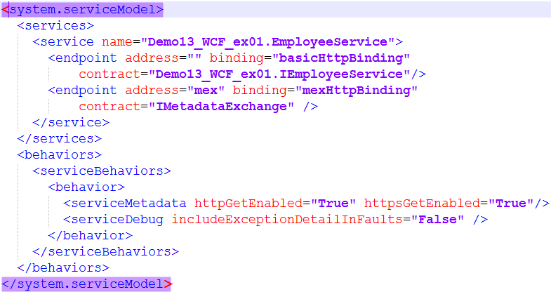
Hosting in Internet Information Services - 3
Edit Web.config file

Slide 39
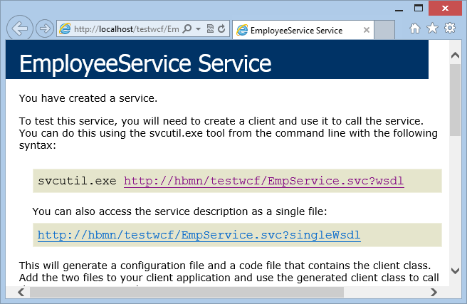
Hosting in Internet Information Services - 4

Slide 40
Hosting in a Managed Application (Self hosting)
Hosting in a Managed Application
To host a service inside a managed application:
Embed the code for the service inside the managed application code,
Define an endpoint for the service either imperatively in code, declaratively through configuration, or using default endpoints,
Create an instance of ServiceHost.
Hosting a service in a managed application is the most flexible option because it requires the least infrastructure to deploy.

Slide 41
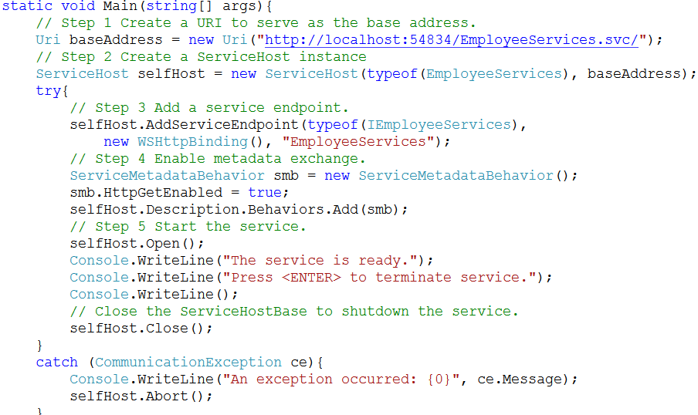
Hosting in a Managed Application - 2

Slide 42
Host a WCF Service in a Managed WS - 1
Hosting in Managed Windows Service
The managed Windows service hosting option that is a long-running WCF service hosted outside of Internet Information Services (IIS) in a secure environment that is not message activated.
The lifetime of the service is controlled instead by the operating system.
This hosting option is available in all versions of Windows.

Slide 43
Host a WCF Service in a Managed WS - 2
Hosting in Managed Windows Service (cond.)
Windows services can be managed with the Microsoft.ManagementConsole.SnapIn in Microsoft Management Console (MMC) and can be configured to start up automatically when the system boots up.
This hosting option consists of registering the application domain (AppDomain) that hosts a WCF service as a managed Windows service so that the process lifetime of the service is controlled by the Service Control Manager (SCM) for Windows services.

Slide 44

Host a WCF Service in a Managed WS - 3
Steps 1
Add new Console Application
Add references:
System.ServiceModel.dll
System.ServiceProcess.dll
System.Configuration.Install.dll
Your WCF app
System.Runtime.Serialization
Steps 2
Add new class Windows Service class
Override OnStart method to start the Windows service.
Override OnStop method to stop the Windows service.
Create Main method to run service

Slide 45
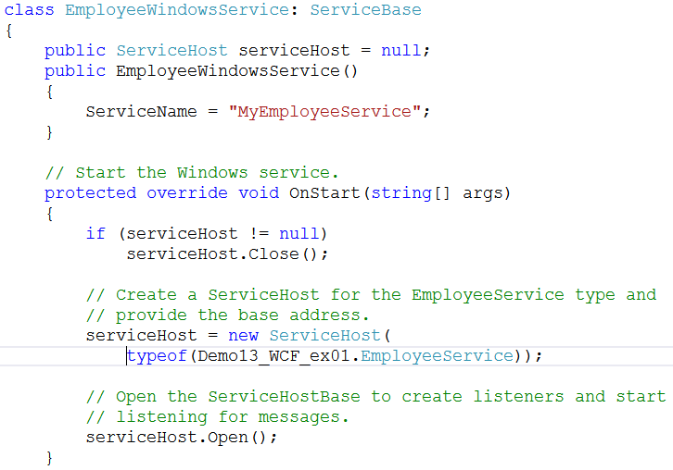
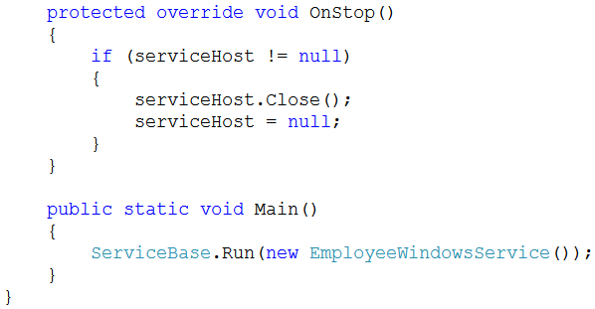
Host a WCF Service in a Managed WS - 4
Steps 2 (contd.)

Slide 46
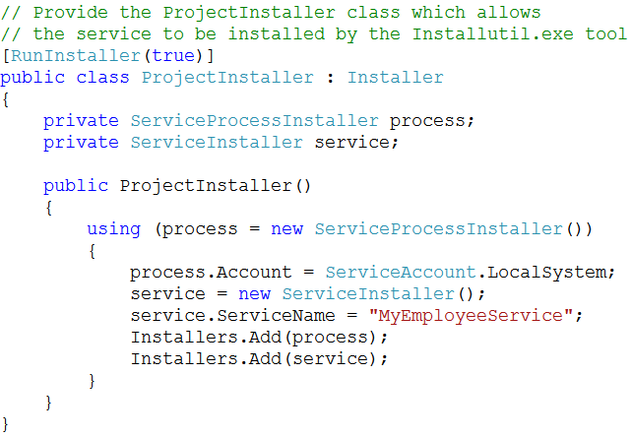
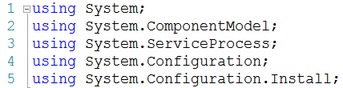
Host a WCF Service in a Managed WS - 5
Steps 3
Create a new class called ProjectInstaller that:
inherits from Installer and
that is marked with the RunInstallerAttribute set to true.
This allows the Windows service to be installed by the Installutil.exe tool.

Slide 47
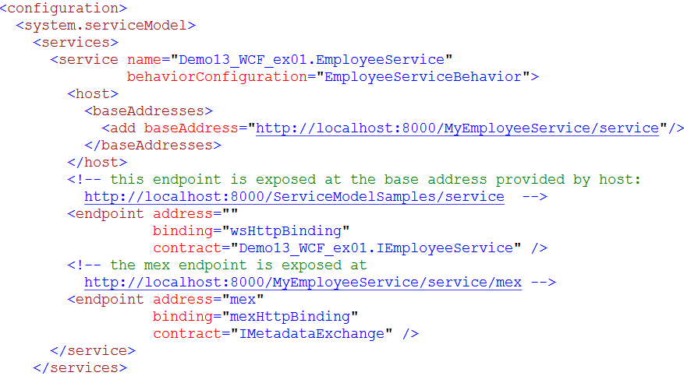
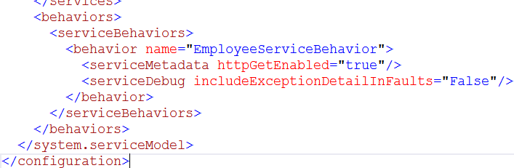
Host a WCF Service in a Managed WS - 6
Steps - 4: Add an application configuration file to the project

Slide 48

Host a WCF Service in a Managed WS - 7
Steps 5
Install and run the service
Open the Visual Studio 2012 command prompt (Run as Administrator) and navigate to the project directory
Using installutil tool to register service to Windows
Open Service Control Manager (SCM) => The service should appear in Services with name that you registed.
Start service
If you make changes to the service, you must first stop it and uninstall it
Uninstall service using tool installutil /u

Slide 49
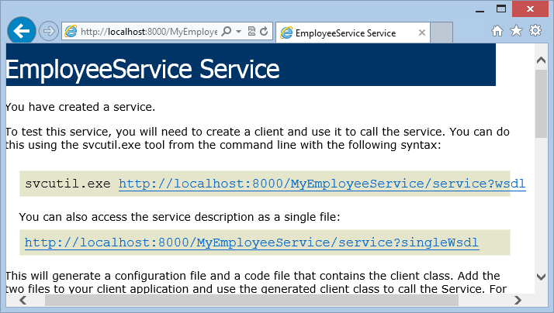
Host a WCF Service in a Managed WS - 8
Steps - 6: View result

Slide 50
WCF Client
A client application is a managed application that uses a WCF client to communicate with another application. To create a client application for a WCF service requires the following steps:
Obtain the service contract, bindings, and address information for a service endpoint.
Create a WCF client using that information.
Call operations.
Close the WCF client object.
Using svcutil tool to generate proxy
Add service reference to wsdl uri

Slide 51
Windows Communication Foundation Demo

Slide 52
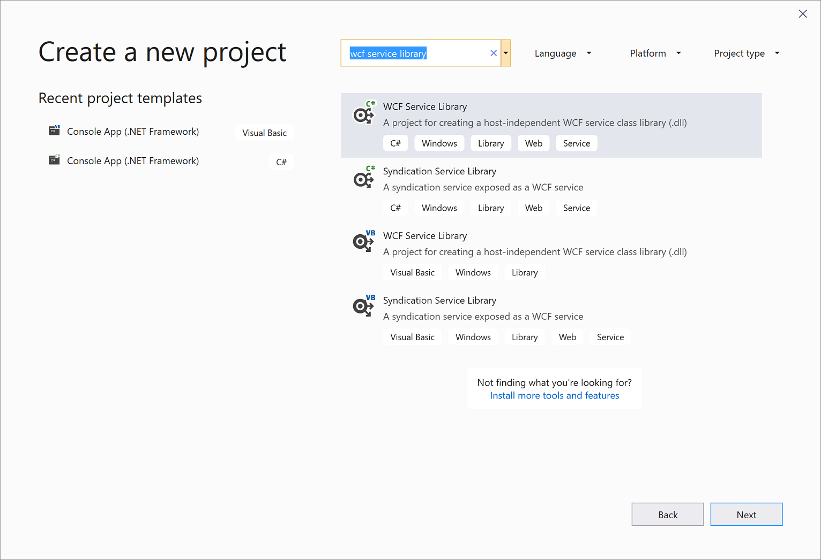
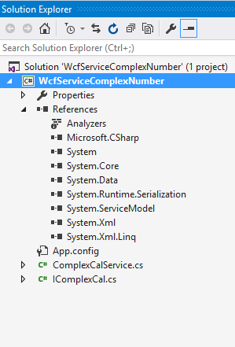
Create WCF Service Library
Create Project WCF Service Library

Slide 53
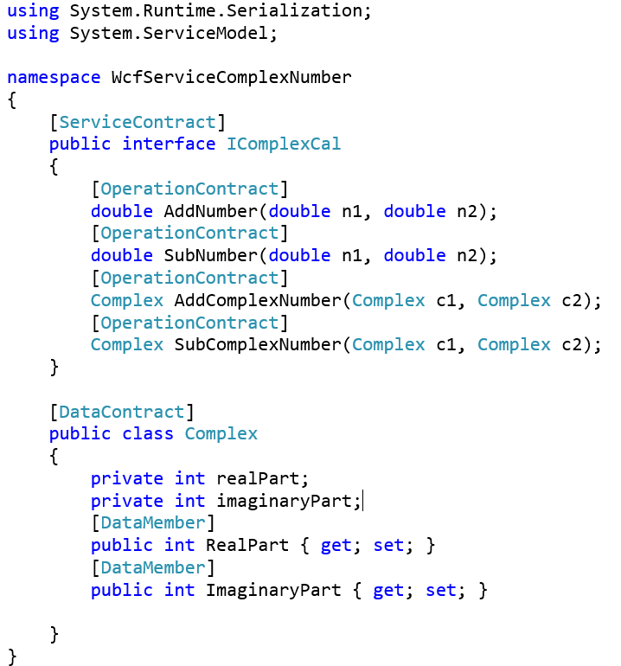
Sevice Contract and Data Contract
Create methods with [OperationContract] annotation in [ServiceContract] IComplexCal
Create [DataContract] and [DataMember]

Slide 54
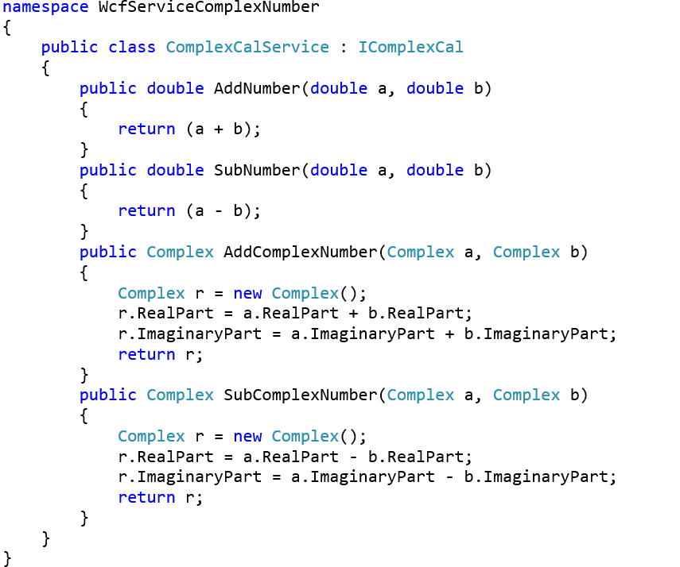
Implement [OperationContract]
Implement the [OperationContract] method in [ServiceContract]

Slide 55
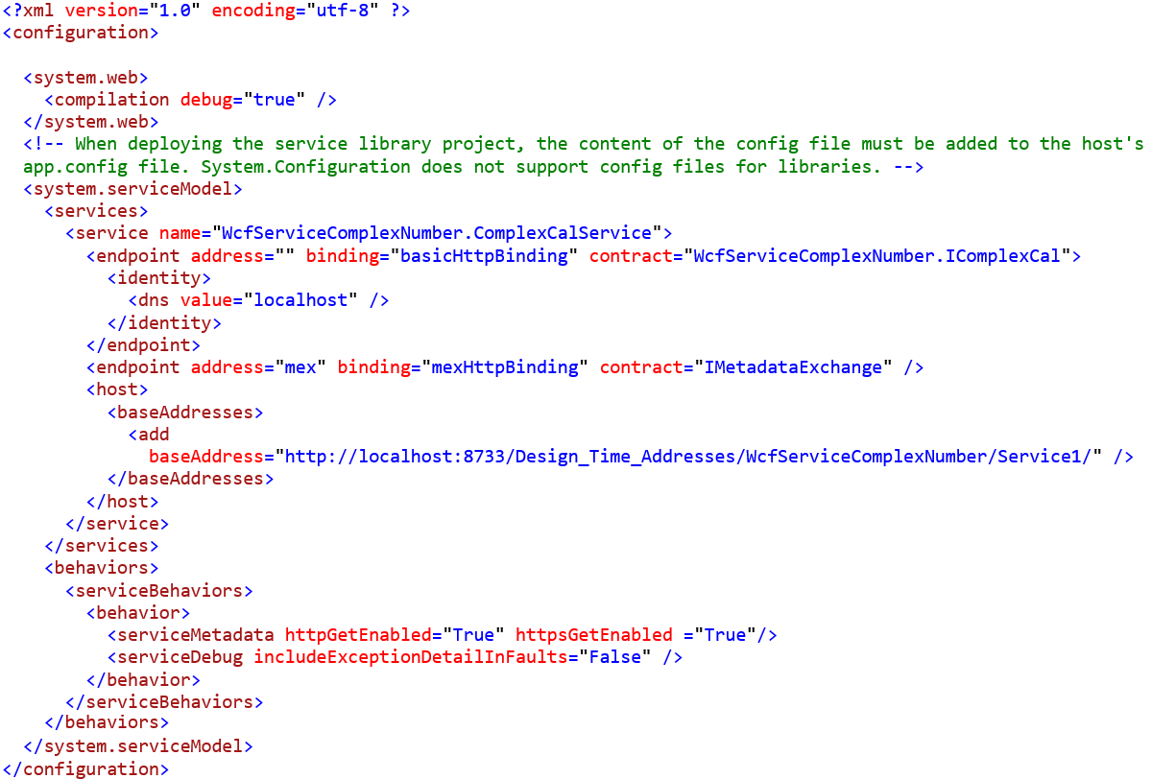
Hosting WCF Service with Base Address

Slide 56
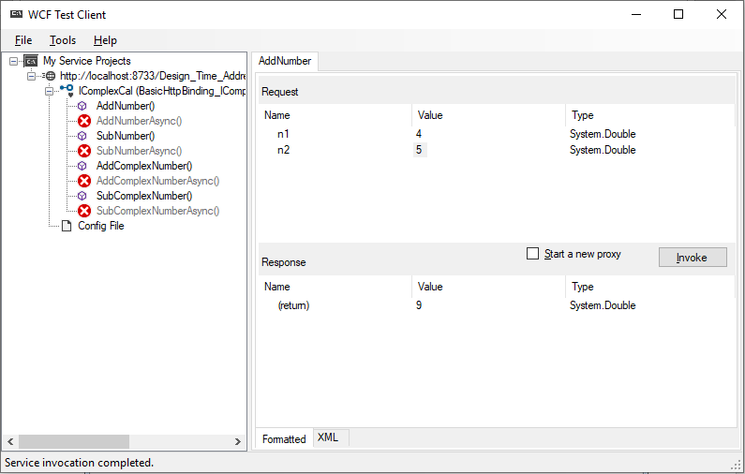
Check with WCF Test Client
Run Project
Check with WCF Test Client

Slide 57
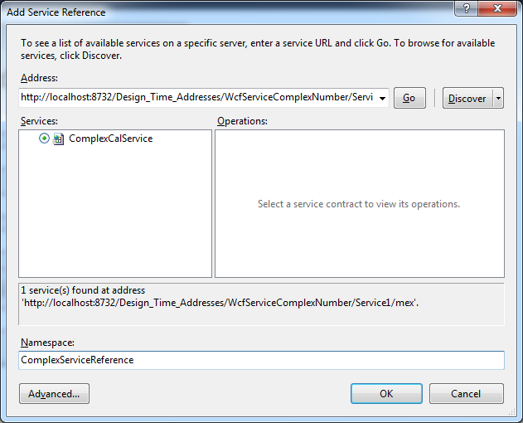
Add Service Reference to Client Project

Slide 58
Summary
Concepts were introduced:
Windows Communication Foundation (WCF) Concepts
Features of WCF
WCF Architecture
WCF Service Design
WCF Client
Demo WCF application

